Slide 1
Unit Operations Review
Staged Separation
Absorption, Stripping, & Distillation
Homa Keshmiri​
Alex Lam​
Yemi Ogunsola​
Amanda Schroeder​
Melody Simmons​

Slide 2
01
03
Introduction
Stripping
02
04
Absorption
Distillation
05
Conclusion

Slide 3
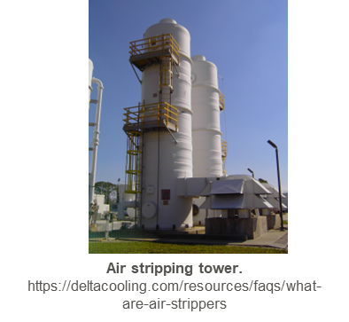
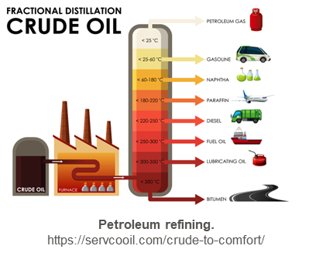
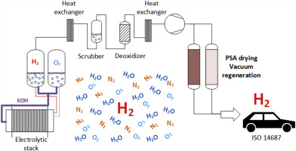
Separator Applications
Absorption
Stripping
Distillation
Removes contaminants in gas mixtures through contact with a liquid absorbent
Removes volatile components from a liquid by heat or stripping with a gas
Separates components of a mixture through boiling point differences
Flue gas pollutant removal
Hydrogen purification
Water treatment
Solvent recovery
Ammonia stripping
Petroleum refining
Cryogenic distillation
Alcohol production
H₂ removal.
https://www.sciencedirect.com/science/article/abs/pii/S0360319920305176

Slide 4
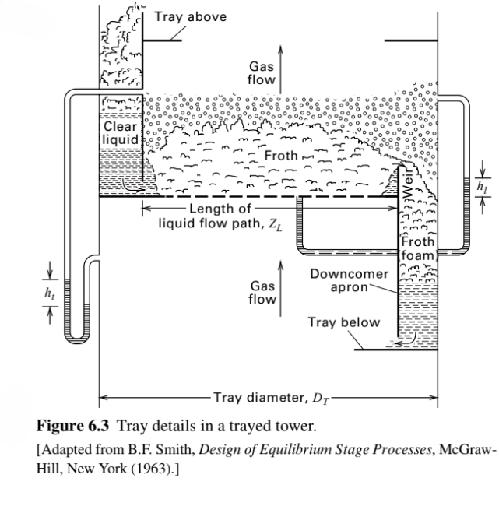
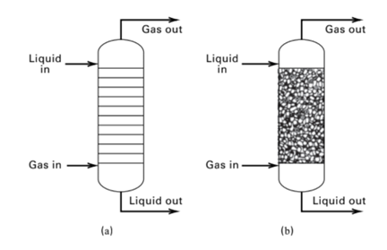
Absorption and Stripping Overview
Physical Adsorption
& Chemical Adsorption
Trayed vs Packed
Columns
Seader, J. D., Henley, E. J., Roper, D. K. Separation Process Principles. 3rd edition. Wiley.

Slide 5
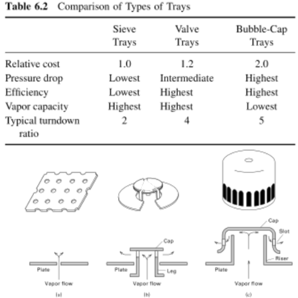
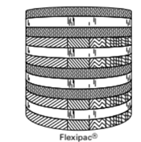

Trayed vs Packed Column
Tray cost, pressure drop, efficiency, and turnover ratio are key design elements
Packed column internals include supports, liquid distributors, and liquid redistributors.
Random and Structured Packing are the two types of packing.
Packing materials commonly
include metal, ceramic, and plastic.
Seader, J. D., Henley, E. J., Roper, D. K. Separation Process Principles. 3rd edition. Wiley.

Slide 6
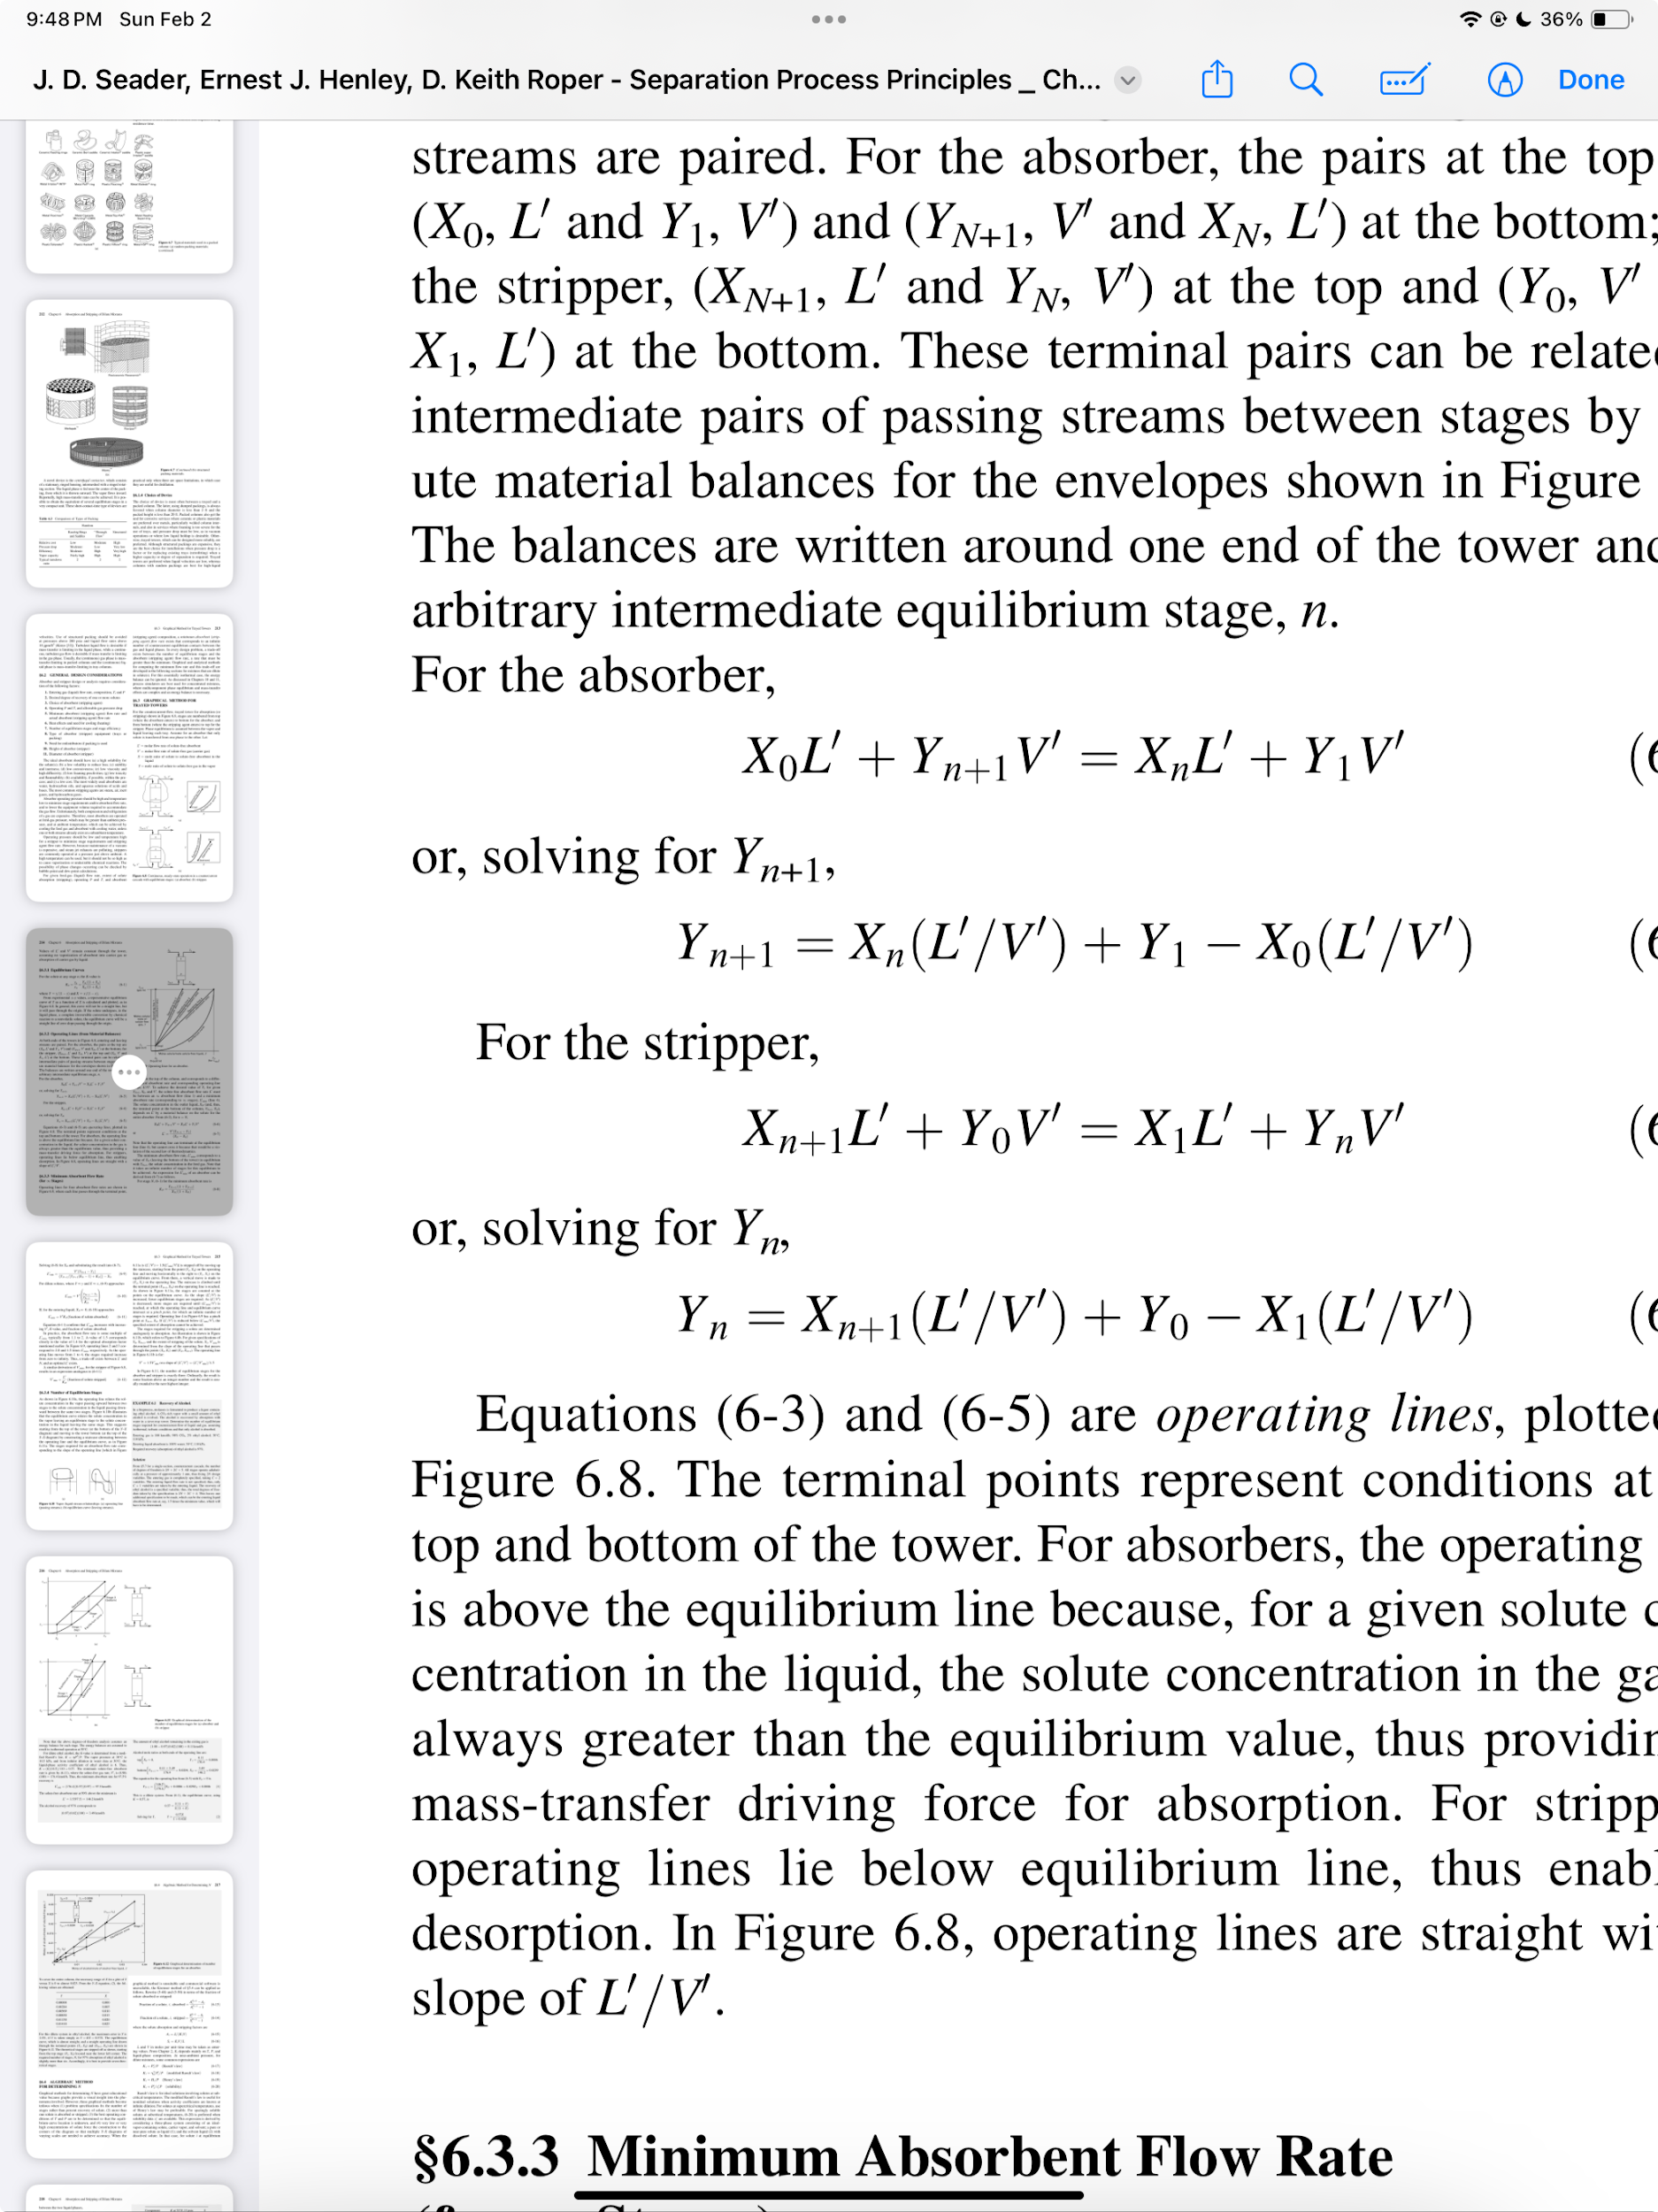
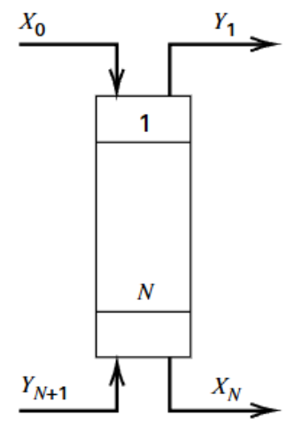
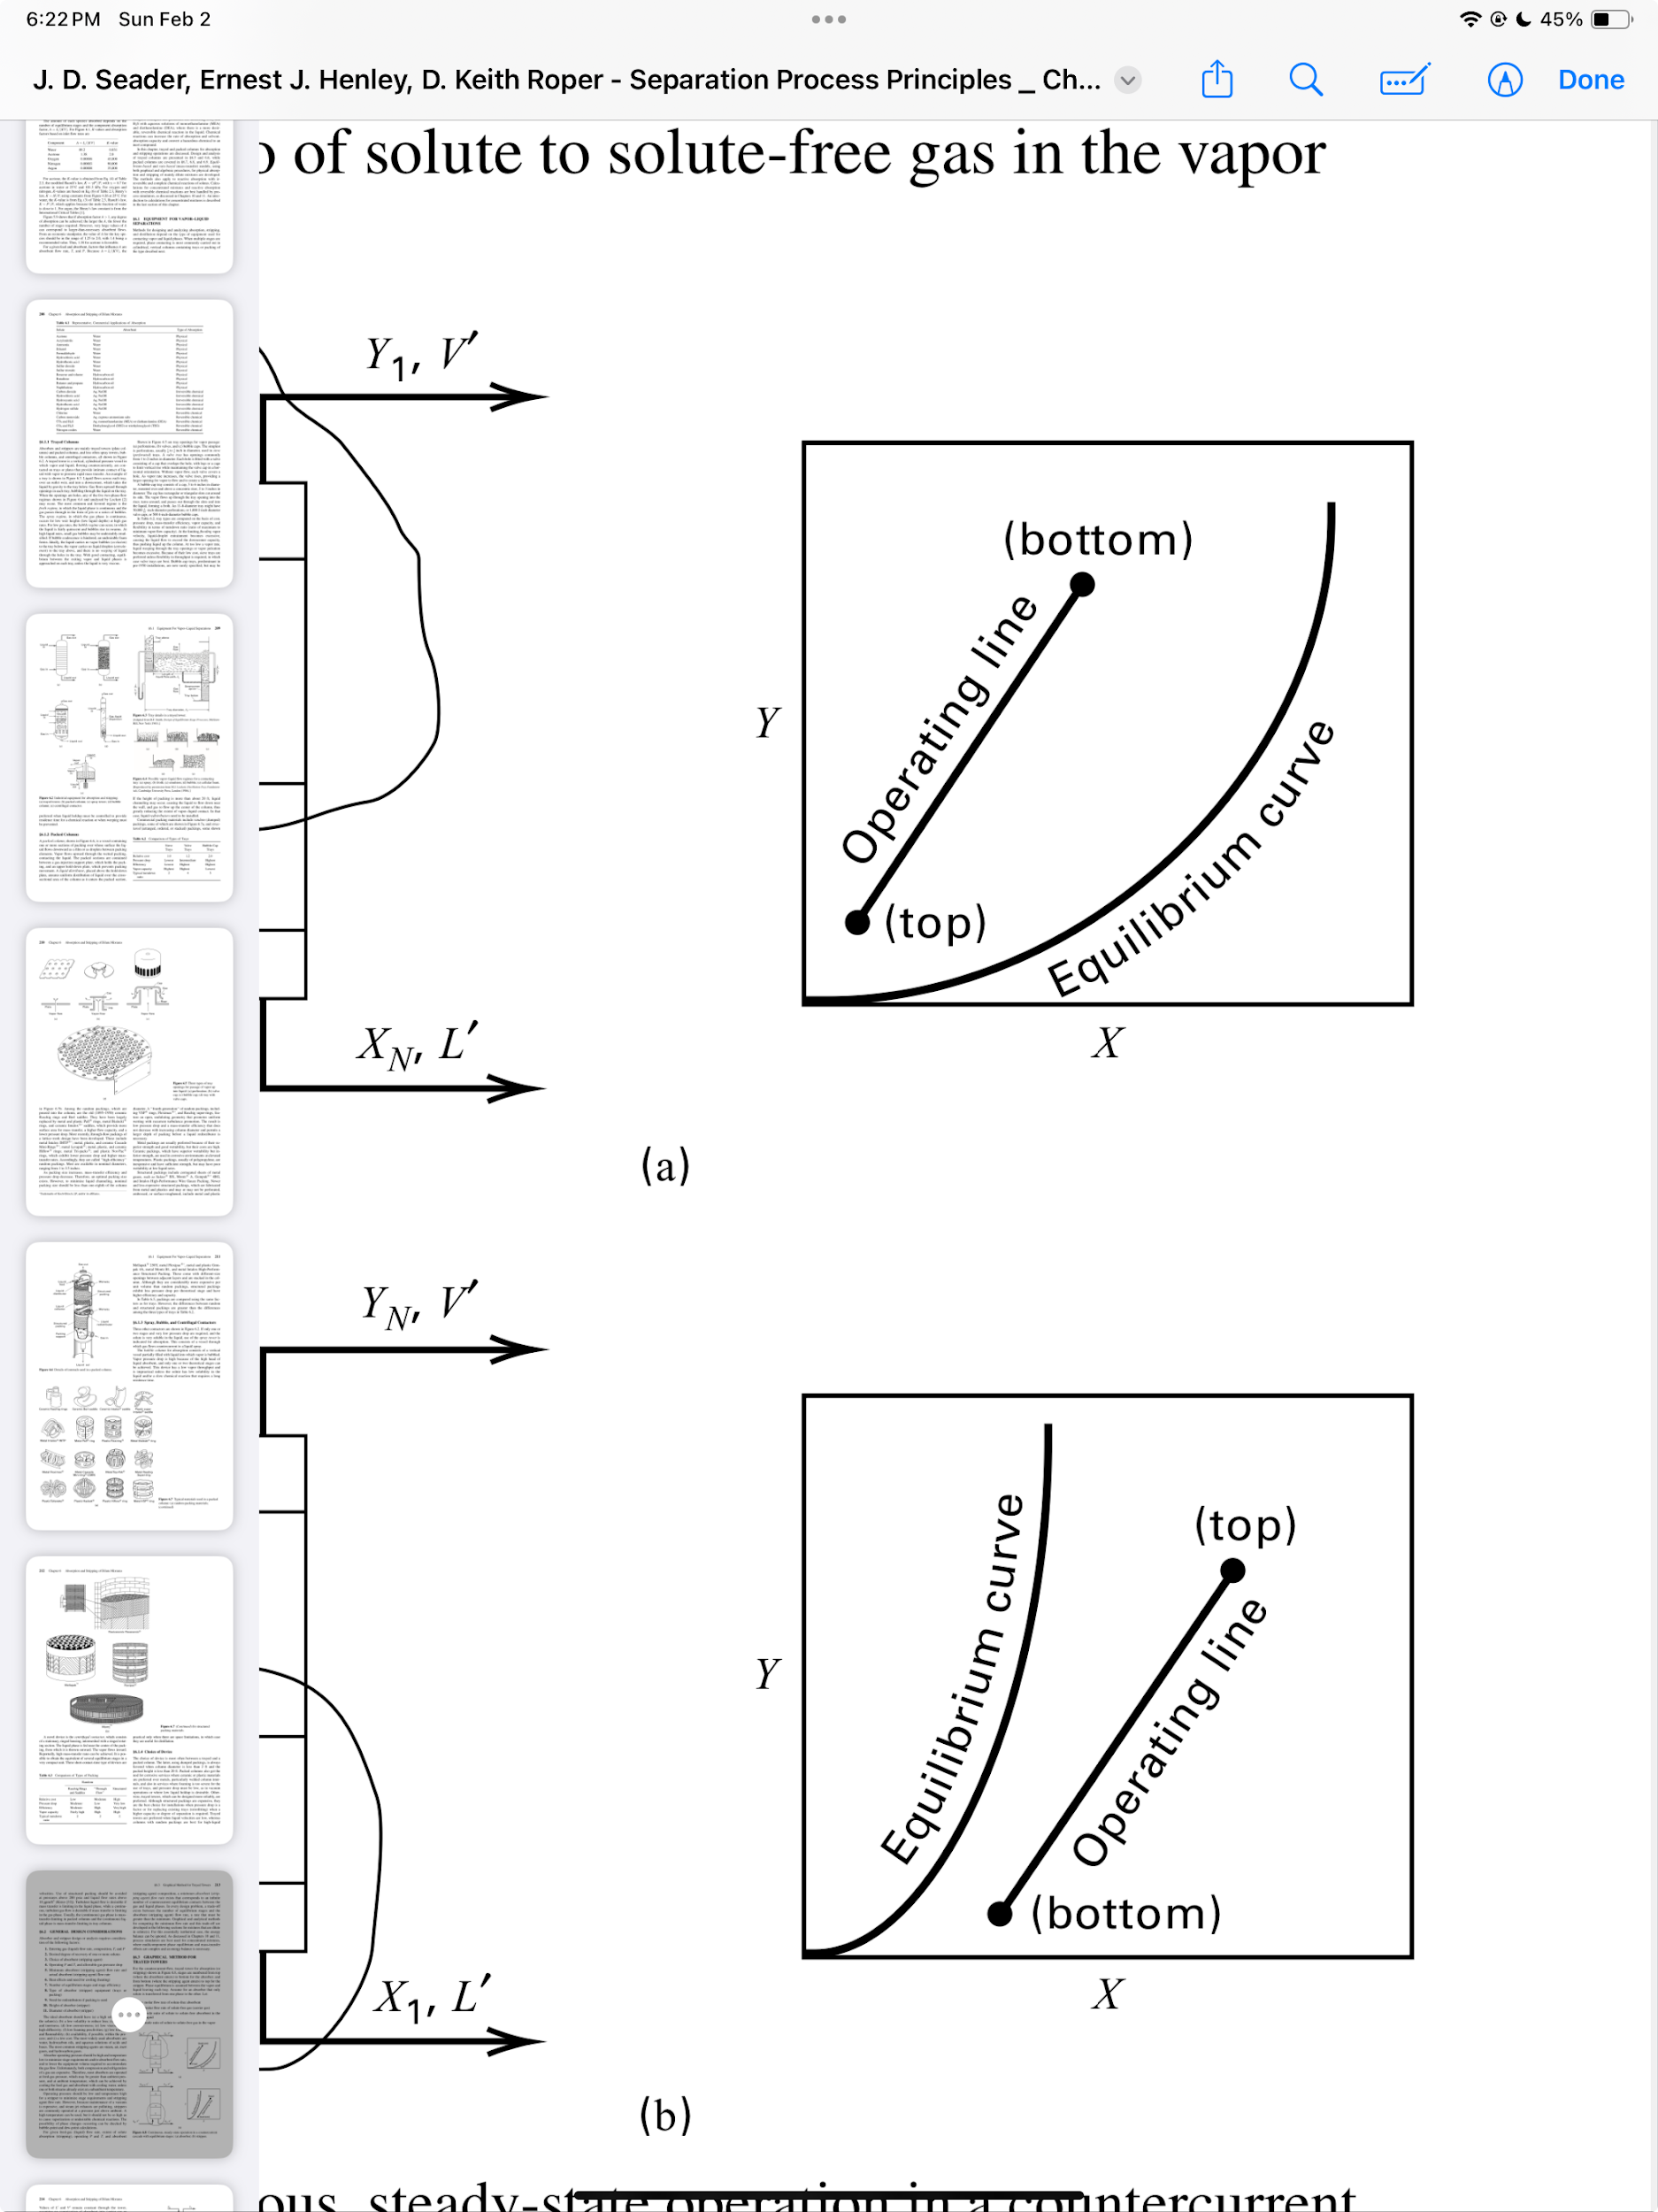
Graphical Method
Assumptions
Tray phase equilibrium
Negligible weeping
Only solute is transferred between stages
Absorption & Stripping Trayed Towers
Design Equations
N + 1
N
N
1
0
1
Absorption: operating line lies above equilibrium curve
Stripping: operating line lies below equilibrium curve
Seader, J. D., Henley, E. J., Roper, D. K. Separation Process Principles. 3rd edition. Wiley.

Slide 7
Example Absorption Problem
Molasses fermentation → CO₂- rich vapor with a small amount of EtOH
Alcohol is recovered by absorption with water
How many equilibrium stages are required in a sieve-tray tower for countercurrent flow of liquid and gas?
Assume isothermal, isobaric conditions and that only alcohol is absorbed.
Entering gas: 180 kmol/h; 98% CO₂, 2% EtOH
Entering liquid (absorbent): 100% water
30 °C
110 kPa
Required recovery: 97% EtOH

Slide 8
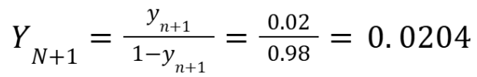

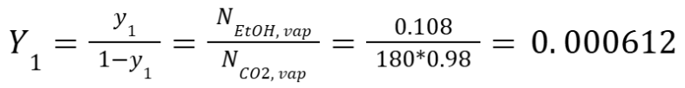
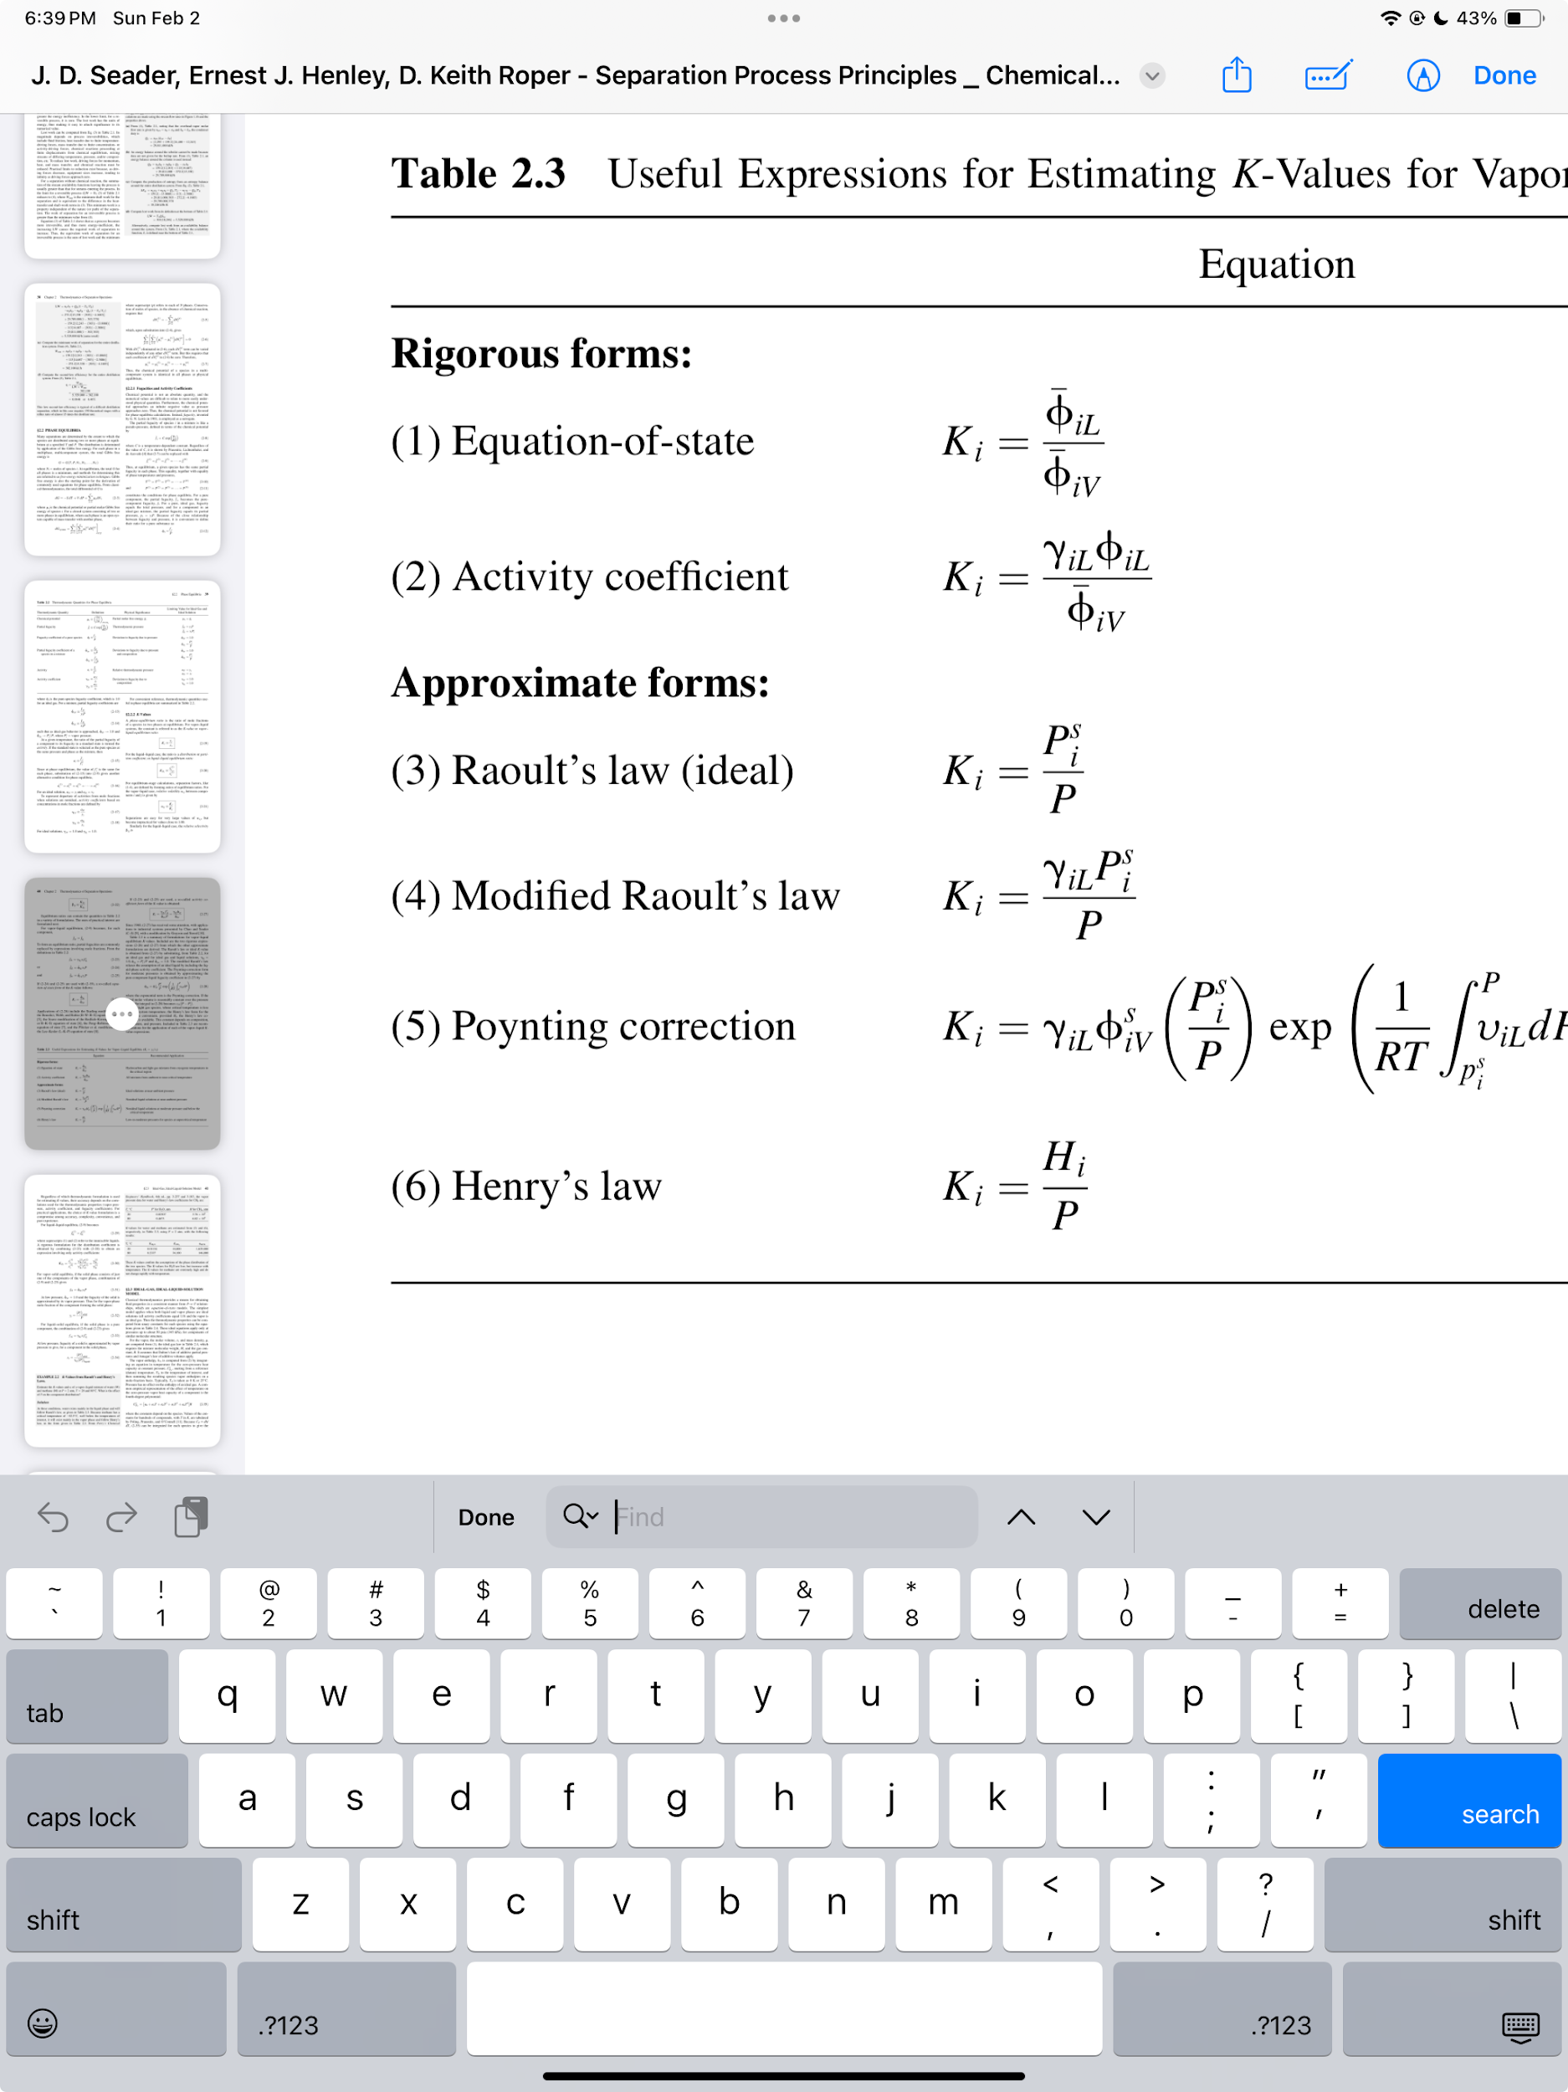
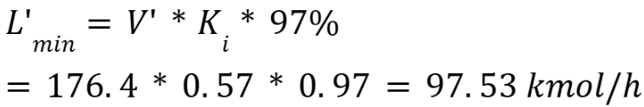
Solution- Step One
X₀ = 0
L’ = ?
Y₁ = 0.00061
Y₁ = ?
L’ = 146 kmol/h
L’ = ?
30 °C
110 kPa
K_{i}=0.57
X_{N} = 0.0239
X_{N} = ?
Y_{N+1} = 0.0204
V’ = 176.4 kmol/h
Y_{N+1} = ?
V’ = ?
V = 180 kmol/h
y_{N+1} = 0.02
Y_{N+1} = ?
V’ = ?
97% of the EtOH

Slide 9
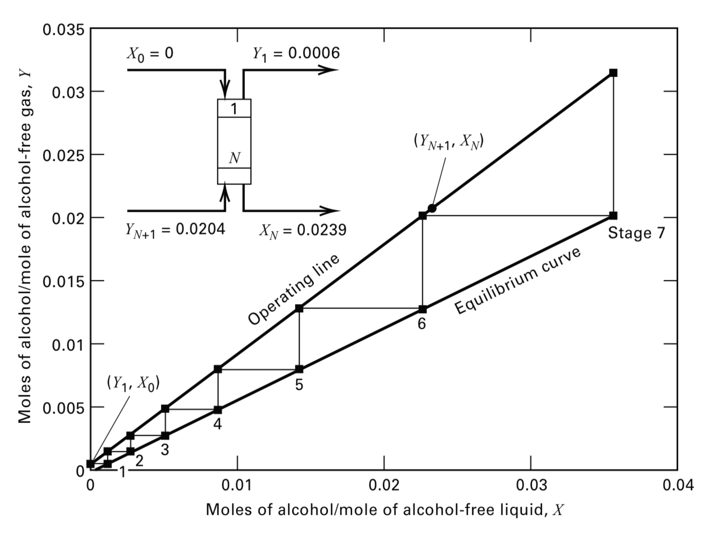
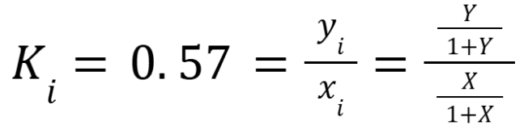
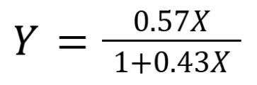
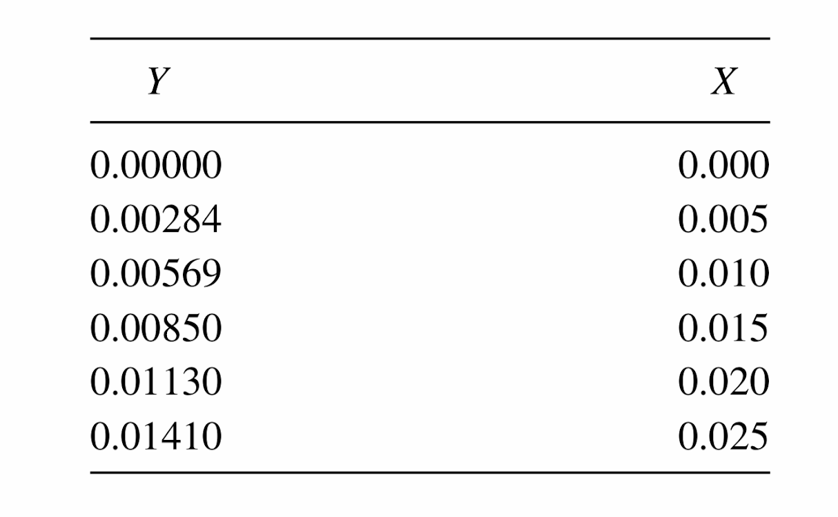
Solution- Step Two
…
(Y_{N+1} , X_{N} )
= (0.0204, 0.0239)
.
.
.
.
.
(Y₁ , X₀ ) = (0.0006, 0)
.
7 stages
.
.
.
Seader, J. D., Henley, E. J., Roper, D. K. Separation Process Principles. 3rd edition. Wiley.

Slide 10
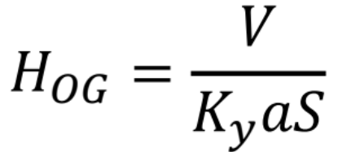
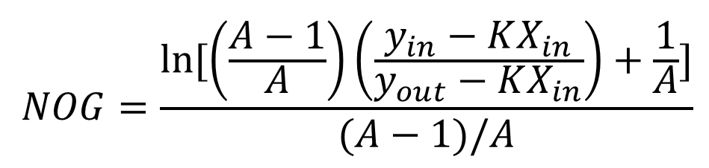
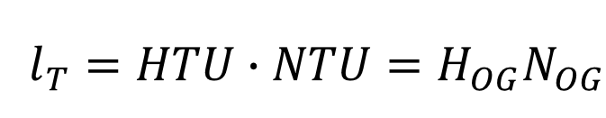
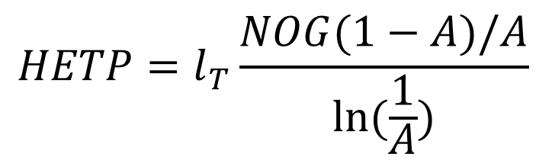
Mass Transfer: Two Film Theory
Mass transfer theory is a theoretical model to use the non-discrete equilibrium stages to determine the packed column properties in absorption.
HTU: Overall Height of (Gas) Transfer Units (H0G)
NTU: Overall Number of (Gas) Transfer Units (NOG)
Packing Height
Assumptions
Dilute System
Constant Cross-Section Area (S)
Height Equivalent to Theoretical Plate

Slide 11
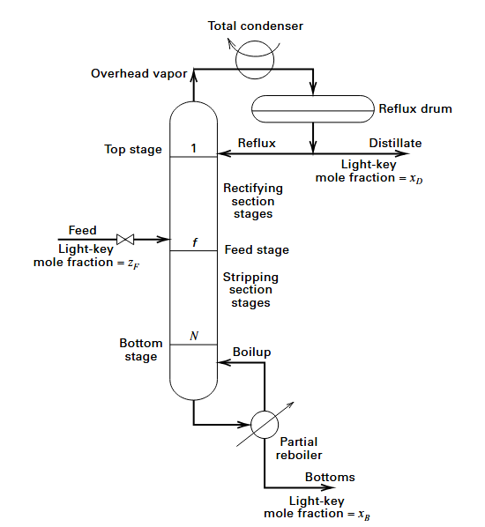
Distillation Overview
Distillation: Separates components in a liquid mixture by using difference in boiling points
Vapor feed mixture goes to condenser
Reflux drum separates into liquid distillate and reflux
Reflux goes down trays to reboiler to create boil up vapor and bottoms
Seader, J. D., Henley, E. J., Roper, D. K. Separation Process Principles. 3rd edition. Wiley.
Notes:
Purpose of distillation is to separate components in a liquid mixture by using the difference in boiling points
Goal of distillation: Create a distillate rich in light key component and bottoms rich in heavy key component
The feed mixture is heated beforehand in a boiler to its dew point, then the vapor feed mixture goes to the condenser, the reflux drum separates into reflux and distillate, reflux goes down to trays to reboiler to create boilup vapor and bottoms.
Additionally, on these trays, the vapor comes into contact with the liquid which further promotes separation by stripping the more volatile component by mass transfer.

Slide 12
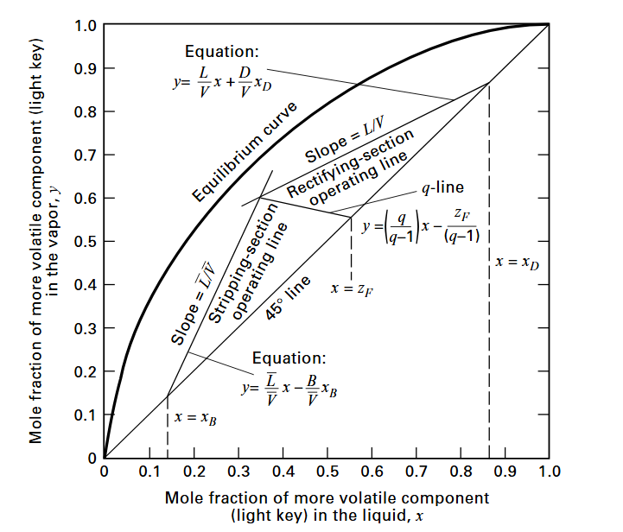



McCabe Thiele Method
The McCabe Thiele Method is a graphical method to demonstrate the distillation of a binary mixture
Minimum number of equilibrium stages
Minimum reflux ratio
Optimal feed stage
Equilibrium stages given certain reflux ratio
Rectifying section operating line
Stripping section operating line
Q-line
Seader, J. D., Henley, E. J., Roper, D. K. Separation Process Principles. 3rd edition. Wiley.
Notes:
Method found in 1925
Graphical method to help demonstrate distillation of a binary mixture that consist of a light key (more volatile) and heavy key (less volatile)
This method helps find minimum number of equilibrium stages, reflux ratio, optimal feed stage, and equilibrium stages given a set reflux ratio
We have the given feed composition and the desired distillate composition and bottoms composition
Equilibrium data between two components is plotted
45 line: where mole fractions of components equal to each other and used to aid in drawing stages
Q-line: Feed line which representation the condition of the feed such as if the liquid is subcooled, bubble point, partially vaporized, dew point, or superheated. Depending on condition, it will affect the slope of this line
Rectifying operating line: Material balance for the stages above the feed stage with the total condenser
Stripping operating line: Material balance for the stages below the feed stage with the partial reboiler

Slide 13
How To Use McCabe Thiele Method
Assumptions:
Two components have equal and constant enthalpies of vaporization
Neglect sensible heat exchange changes and heat mixing
Heat loss is negligible
Column pressure is constant
Seader, J. D., Henley, E. J., Roper, D. K. Separation Process Principles. 3rd edition. Wiley.
Notes:
Assumptions:
Two components have equal and constant enthalpies of vaporization
Neglect sensible heat exchange changes and heat mixing
Heat loss is negligible as the column is insulated
Column pressure is constant

Slide 14
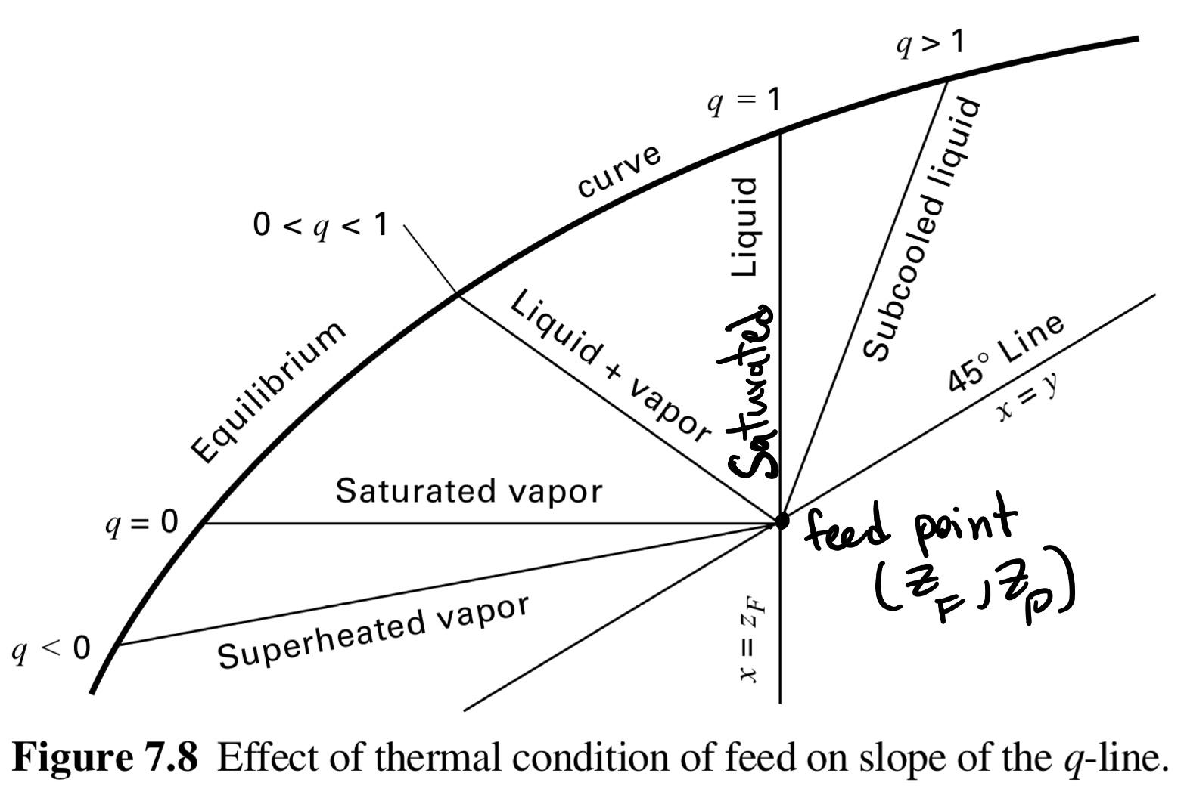
Example Distillation Problem
Problem:
Saturated liquid feed of Toluene and Benzene at .35 kmol/h with .56 mole fraction toluene (1-Z_{F})
Desired Distillate mole fraction Benzene (X_{D}): 0.97
Desired bottoms mole fraction toluene (1-X_{B}): 0.98
Determine…
Number of stages required operating at 2*R_{min}
Seader, J. D., Henley, E. J., Roper, D. K. Separation Process Principles. 3rd edition. Wiley.

Slide 15
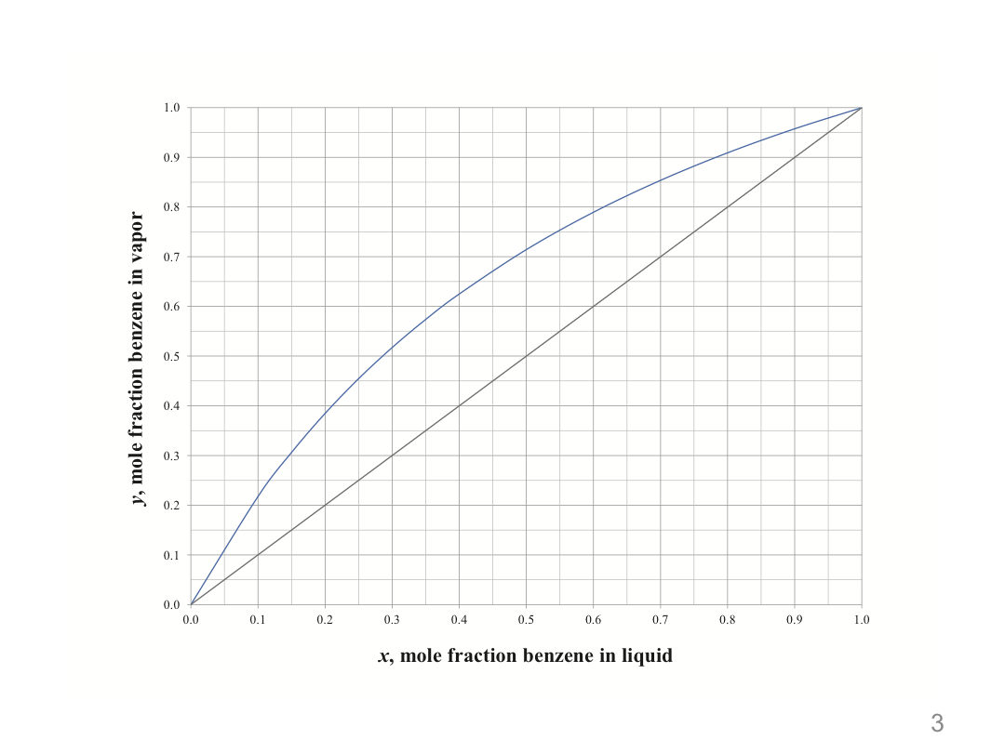


Solution-Step One
Determine R_{min} (pinch point) by finding the slope of the rectifying line:
(0.97, 0.97)
q=1
Slope→ ∞ : vertical line
Q
Line
~(0.44, 0.66)
y=x point
(Z_{F},Z_{F})=(1-0.56, 1-0.56)=(0.44, 0.44)
Given: Toluene feed composition
(0.44, 0.44)
y=x point
(X_{D},X_{D})=(0.97, 0.97)
R
Line
Calculate slope
slope
Calculate R_{min}
R_{min}=1.41
Benzene: more volatile than toluene

Slide 16


Solution-Step two
Determine number of stages at 2xR_{min}
# stages=10
Q
Line
Same as the previous slide
(0.97, 0.97)
y=x point
(X_{D},X_{D})=(0.97, 0.97)
(0.44, 0.58)
R
Line
R_{min}=1.41
R=2xR_{min}=2.81
(0.44, 0.44)
y=0.58
S
Line
(0.02, 0.02)
y=x point
(X_{B},X_{B})=(1-0.98, 1-0.98)= (0.02, 0.02)
Given: Toluene bottoms composition
Benzene: more volatile than toluene

Slide 17
Potential Risks and Challenges
Azeotropic Mixtures
  Pressure Swinging, Add another component, Choose new components
Multi-Component Mixtures
  ASPEN/MATLAB/computer aided simulation for equilibrium mixtures and multi component diagrams on physical properties
Economic Considerations
  Packed Columns have higher operational costs than Tray Columns
  Various Fittings and Modifications and related Energy Costs
  Distillation columns require high volumes of space
Multi-Unit Considerations
  Choose the separation unit’s order to optimize the pre-existing components and physical properties in the process flow

Slide 18
Thanks!
Do you have any questions?

Slide 19
Appendix

Slide 20
Graphical Method
Absorption & Stripping Trayed Towers
Solution Strategy
Mass Balance
Equilibrium data
Plot on Graph
Find Necessary Values
Assumptions
Phase equilibrium occurs for streams leaving a tray
Negligible weeping
Only solute is transferred between stages
Absorption: operating line lies above equilibrium curve
Stripping: operating line lies below equilibrium curve
Seader, J. D., Henley, E. J., Roper, D. K. Separation Process Principles. 3rd edition. Wiley.

Slide 21
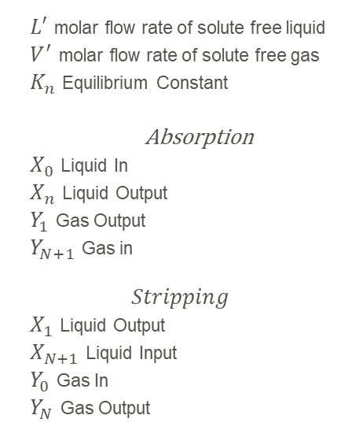
Example: Absorption Trayed Columns
In a bioprocess, molasses is fermented to produce a liquor containing ethyl alcohol. A CO₂-rich vapor with a small amount of ethyl alcohol is evolved.
The alcohol is recovered by absorption with water in a sieve-tray tower. Determine the number of equilibrium stages required for countercurrent flow of liquid and gas, assuming isothermal, isobaric conditions and that only alcohol is absorbed.
Entering gas is 180 kmol h–1; 98%, CO₂, 2% ethyl alcohol, 30 °C, 110 kPa.
Entering liquid absorbent is 100% water, 30 °C, 110 kPa.
Required recovery (absorption) of ethyl alcohol is 97%.

Slide 22
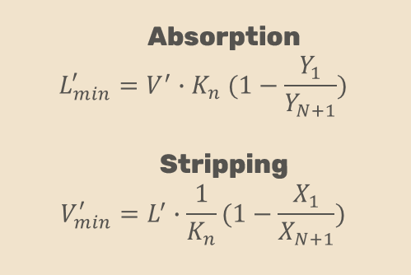
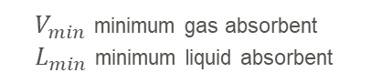
Algebraic Method
Find the Minimum Liquid OR Gas Flow Rate
Assumptions
Dilute Systems
Pure Gas or Liquid (MSA) Input

